Slide 1
2026 Fall
Lab #8 – Remote Imagery
KestrelSAT Capstone
Lab 8 Final Presentation
C&C Industries
ASTRO 331 – Space Systems Engineering – “Learning Space by doing Space”

Slide 2
Requirements & Progress
Requirement | Verification Method | Status
Remotely capture and transmit images | Reliably and without failure capture and transmit files and images at 1 KBps speed | Complete
RSSI > -100 dB for distances < 100m regardless of obstruction | Measure RSSI with various obstructions while meeting or exceeding -100 dB RSSI | Complete
Establish communication at 2km+ range | Use mapping software to determine 2km+ line-of-sight points and maintain connection | Complete
Transmit a live preview of the image | Maintain 10s intervals of 320p image transmission to the ground station without saturating the connection | Complete
Reqts & Progress
Data & Analysis
Plan & Delivery
2

Slide 3
Requirements & Progress
Backstory (Preliminary)
Initial Beta, focused on upgrading the GCS (and firmware) to enable remote file management
  Learning how XBee works
  Working with Codex to plan and enable our features
  Remote file management
  Upgraded data collection with transfer rate and RSSI polling
Shift towards hardware
  Use XCTU as instructed by Codex to increase baud rate and enable synchronous RSSI polling
  Limit hardware-based failures
  Enable reliable, high transfer rate operations
Integrate image capture and transfer capabilities
  GCS and firmware updates to manage camera and file system remotely
  Fix hardware issues with software improvements
Prototype 1!
  Reliable remote image capture and transmission
Reqts & Progress
Data & Analysis
Plan & Delivery
2

Slide 4
Data, Plots & Analysis
Preliminary data is the centerpiece of this review.
Reqts & Progress
•
Include at least 2 meaningful engineering plots ; 3–4 distinct, relevant plots show stronger progress.
Data & Analysis
•
Show physical satellite test data and theoretical/expected performance plots, unless coordinated otherwise with your instructor.
Plan & Delivery
•
Plots must be readable: titles, labeled axes with units, legends, and relevant test conditions.
For each plot, explain:
1 · MEASURE
2 · COMPARE
3 · EXPLAIN
4 · NEXT
What did you measure, and under what conditions?
What did you expect from theory, simulation, or the requirement?
What do the results mean?
What will you do next: retest, redesign, calibrate?
•
Include unsuccessful or unexpected results. They are part of real engineering; present them with engineering analysis, not just raw data.
3

Slide 5
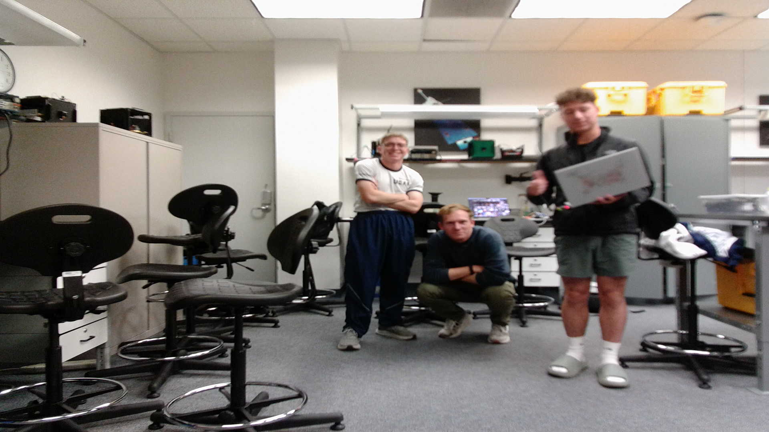
Data, Plots & Analysis
Reqts & Progress
Data & Analysis
Plan & Delivery
1920x1080, ~137KB file size
3

Slide 6
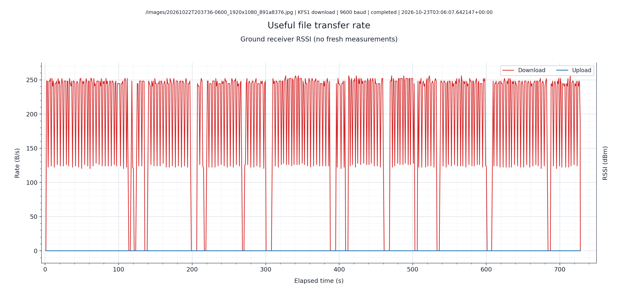
Data, Plots & Analysis
Reqts & Progress
Data & Analysis
Plan & Delivery
3
Notes:
9600 baud rate, broadcast mode, no rssi

Slide 7
Data, Plots & Analysis
Reqts & Progress
Data & Analysis
Plan & Delivery
3
Notes:
115200 baud rate, broadcast mode, w/ rssi

Slide 8
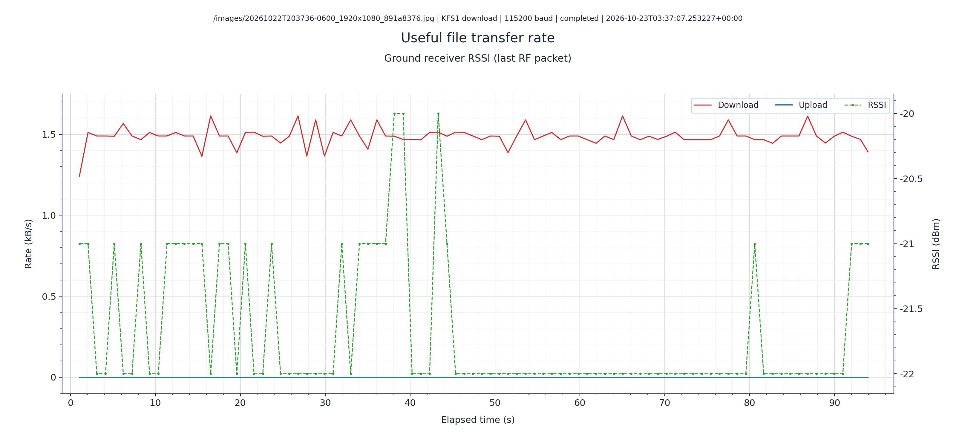
Data, Plots & Analysis
Reqts & Progress
Data & Analysis
Plan & Delivery
3
Notes:
115200 baud rate, unicast mode, w/ rssi

Slide 9
Requirements & Progress
Backstory (Final)
Build off Prototype 1, integrate live preview and improve data-tracking capabilities
  RSSI tracking mode
  Live Preview mode
Improve graphing quality
  Integrate RSSI onto transfer-rate graphs
  Color coordination and readability
  Built directly into the GCS
Hardware improvement
  Long range antennas on both GCS and KestralSAT
Integrate data-transfer speed improvements
  512 bytes (vs 128 bytes)
  Base64 encoding (vs hex)
  Experimental transfer profile utilizing batch 2
Prototype 2!
  Integrates and fulfills (physically possible) requirements
Reqts & Progress
Data & Analysis
Plan & Delivery
2

Slide 10
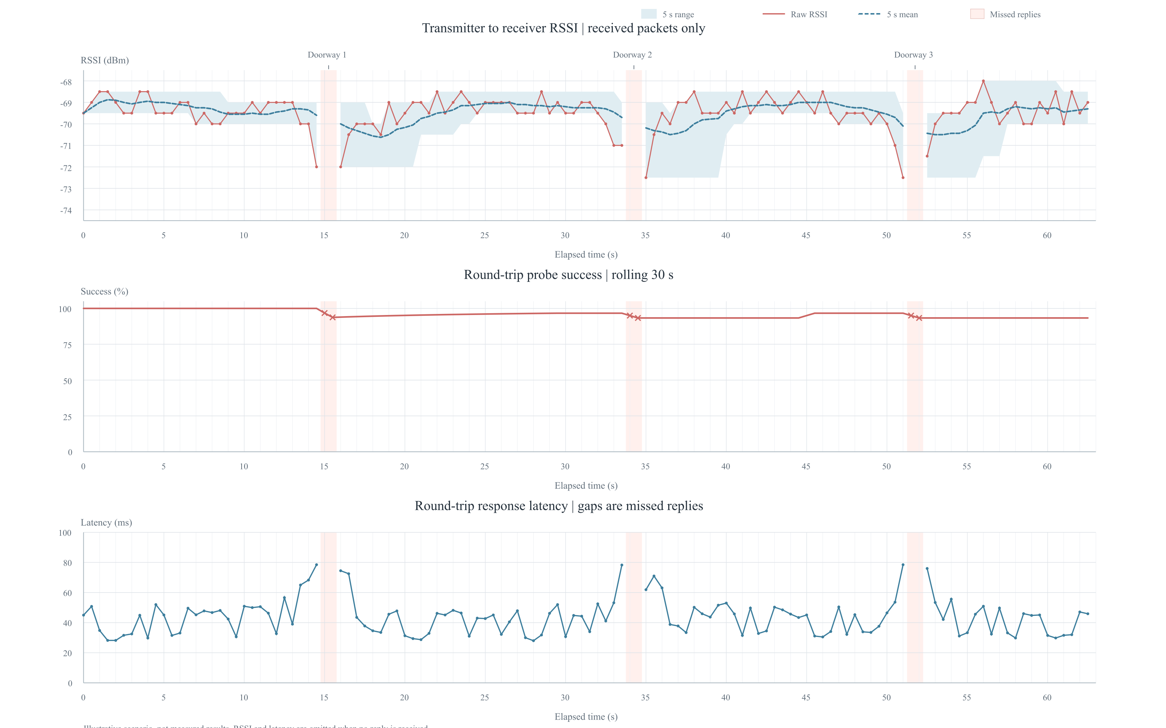
Obstructed Test Results
Able to multipath to achieve >-100dB signal strength in doors for ~25 meters
Met necessary criteria
Limited heavily by obstruction type/thickness
Reqts & Progress
Data & Analysis
Plan & Delivery
3
Notes:
115200 baud rate, unicast mode, w/ rssi

Slide 11
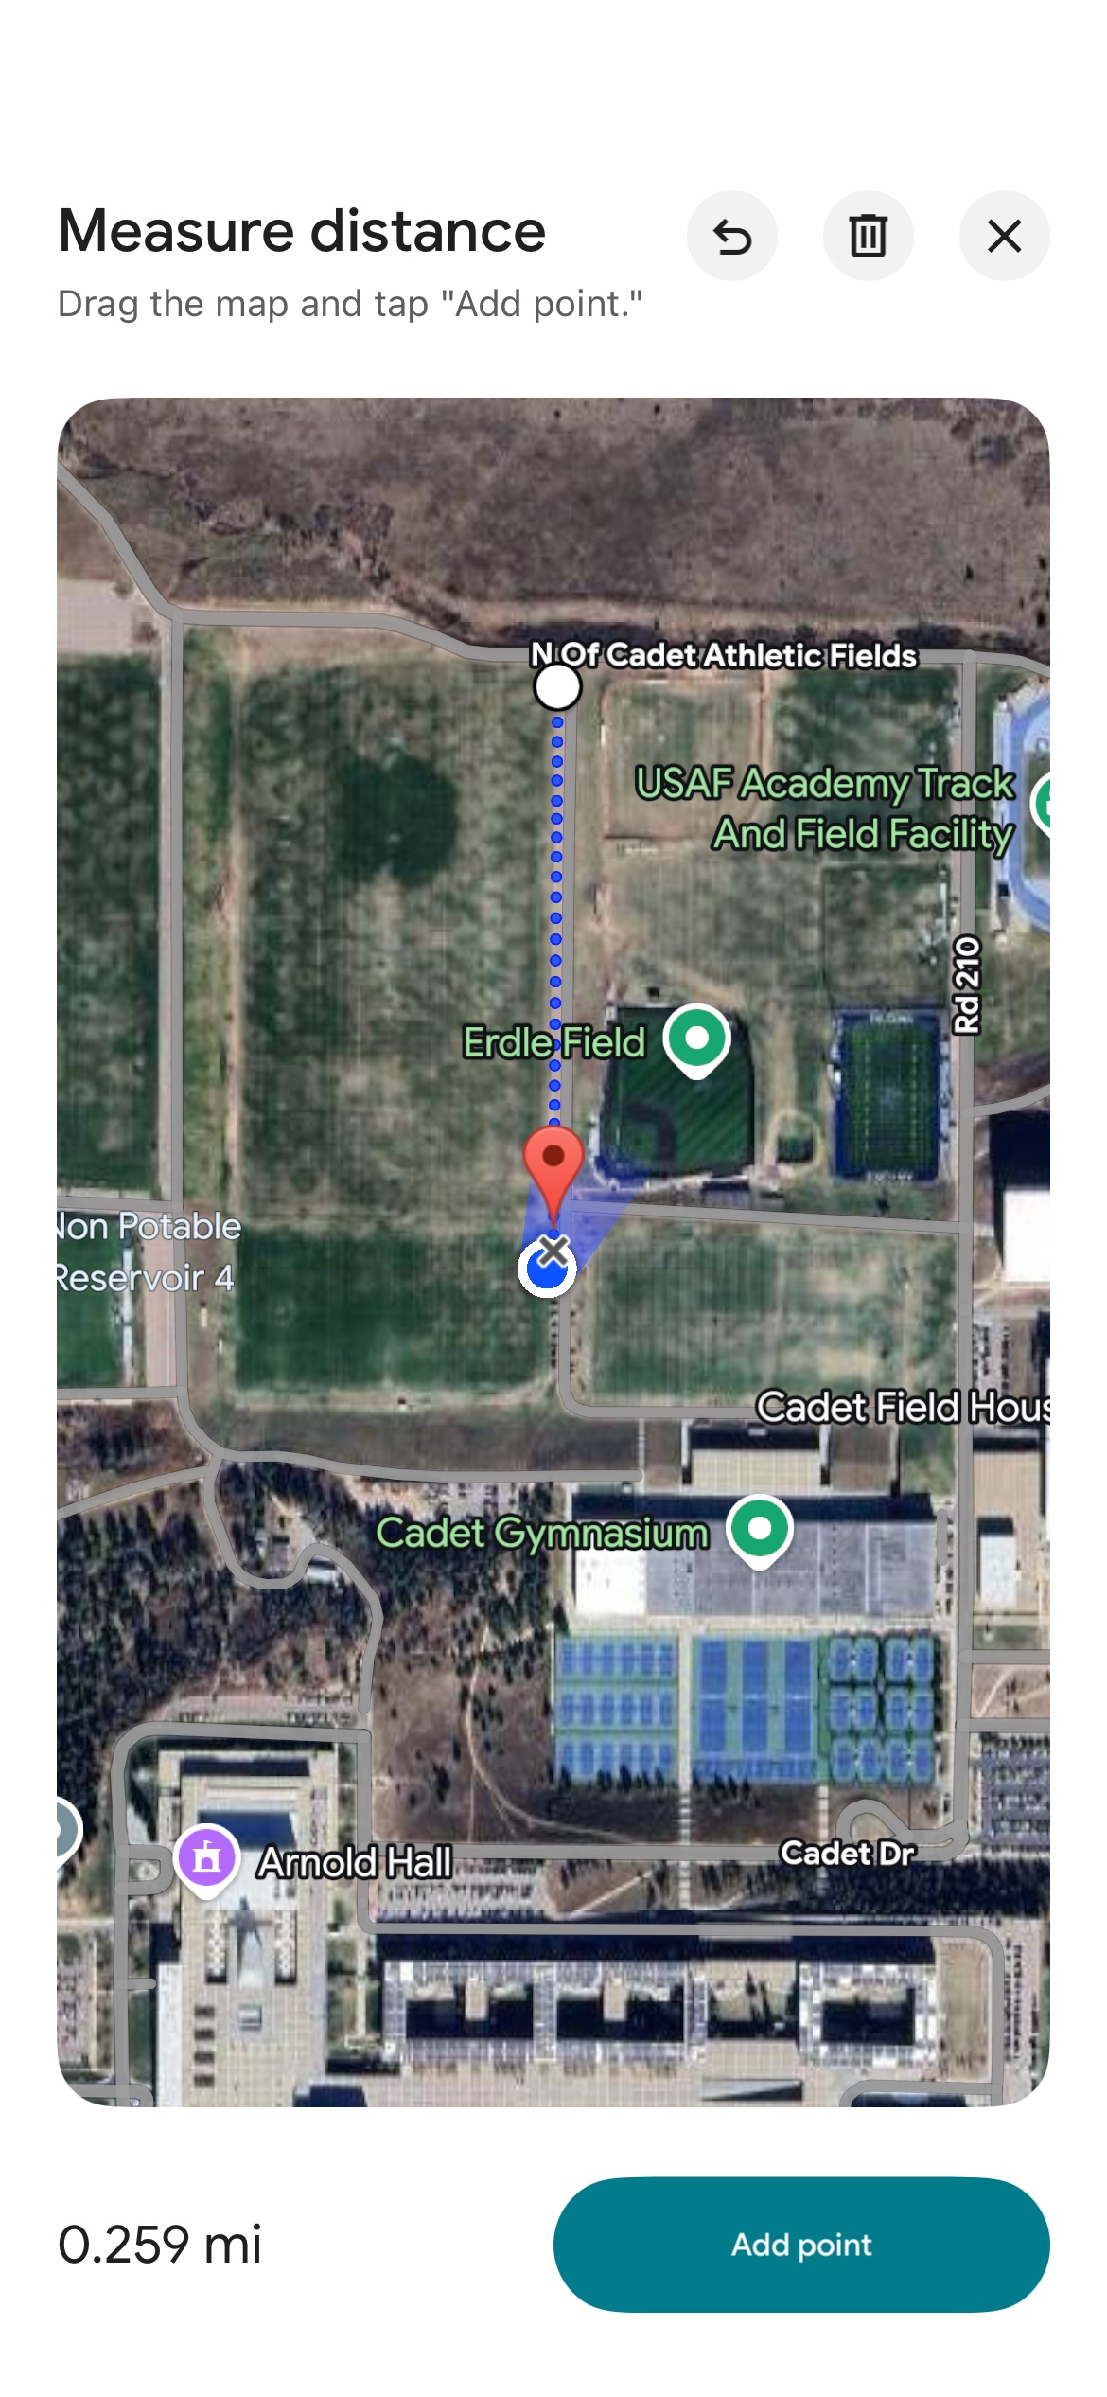
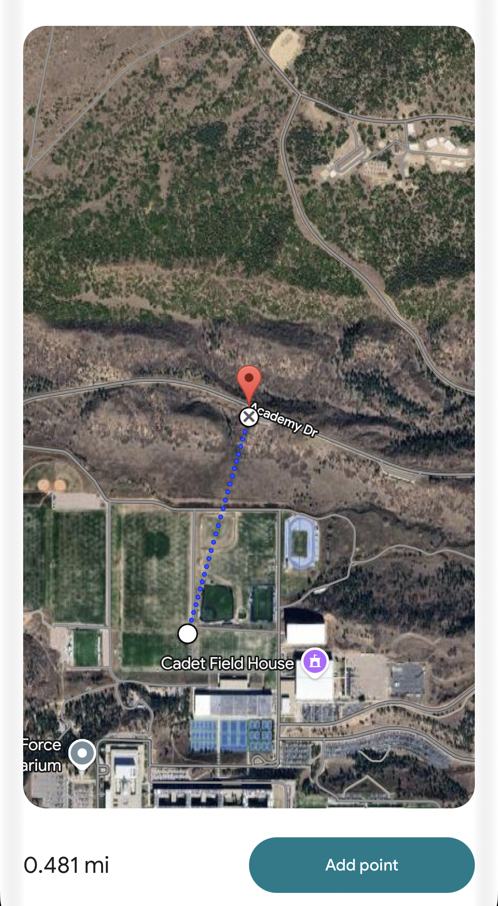
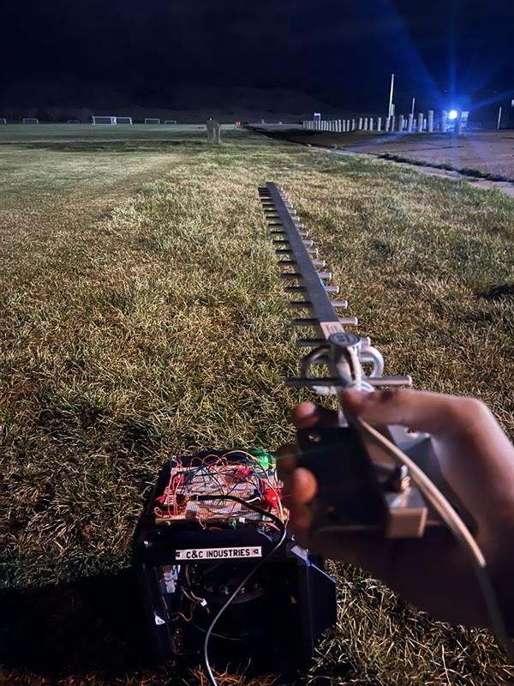
Long-Range Test Setup
Reqts & Progress
Data & Analysis
Plan & Delivery
3
Notes:
115200 baud rate, unicast mode, w/ rssi

Slide 12
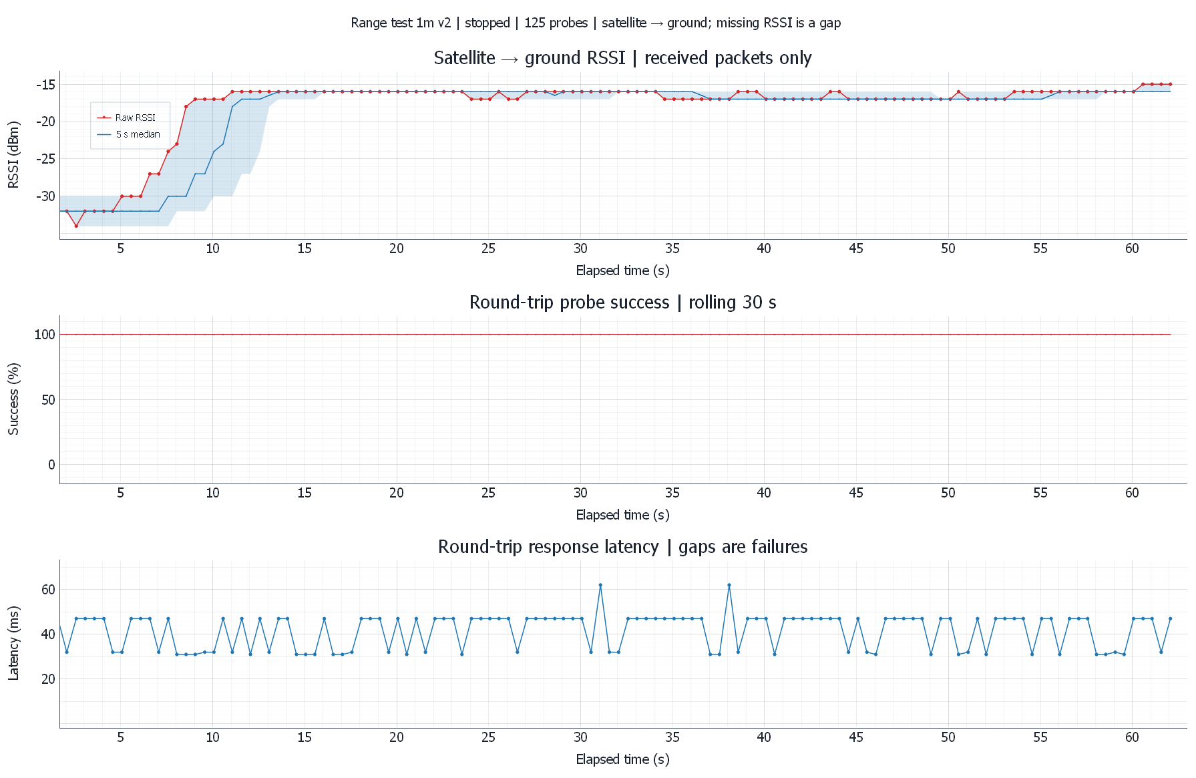
Long-Range Test Setup, 1m
Reqts & Progress
Data & Analysis
Plan & Delivery
3
Notes:
115200 baud rate, unicast mode, w/ rssi

Slide 13
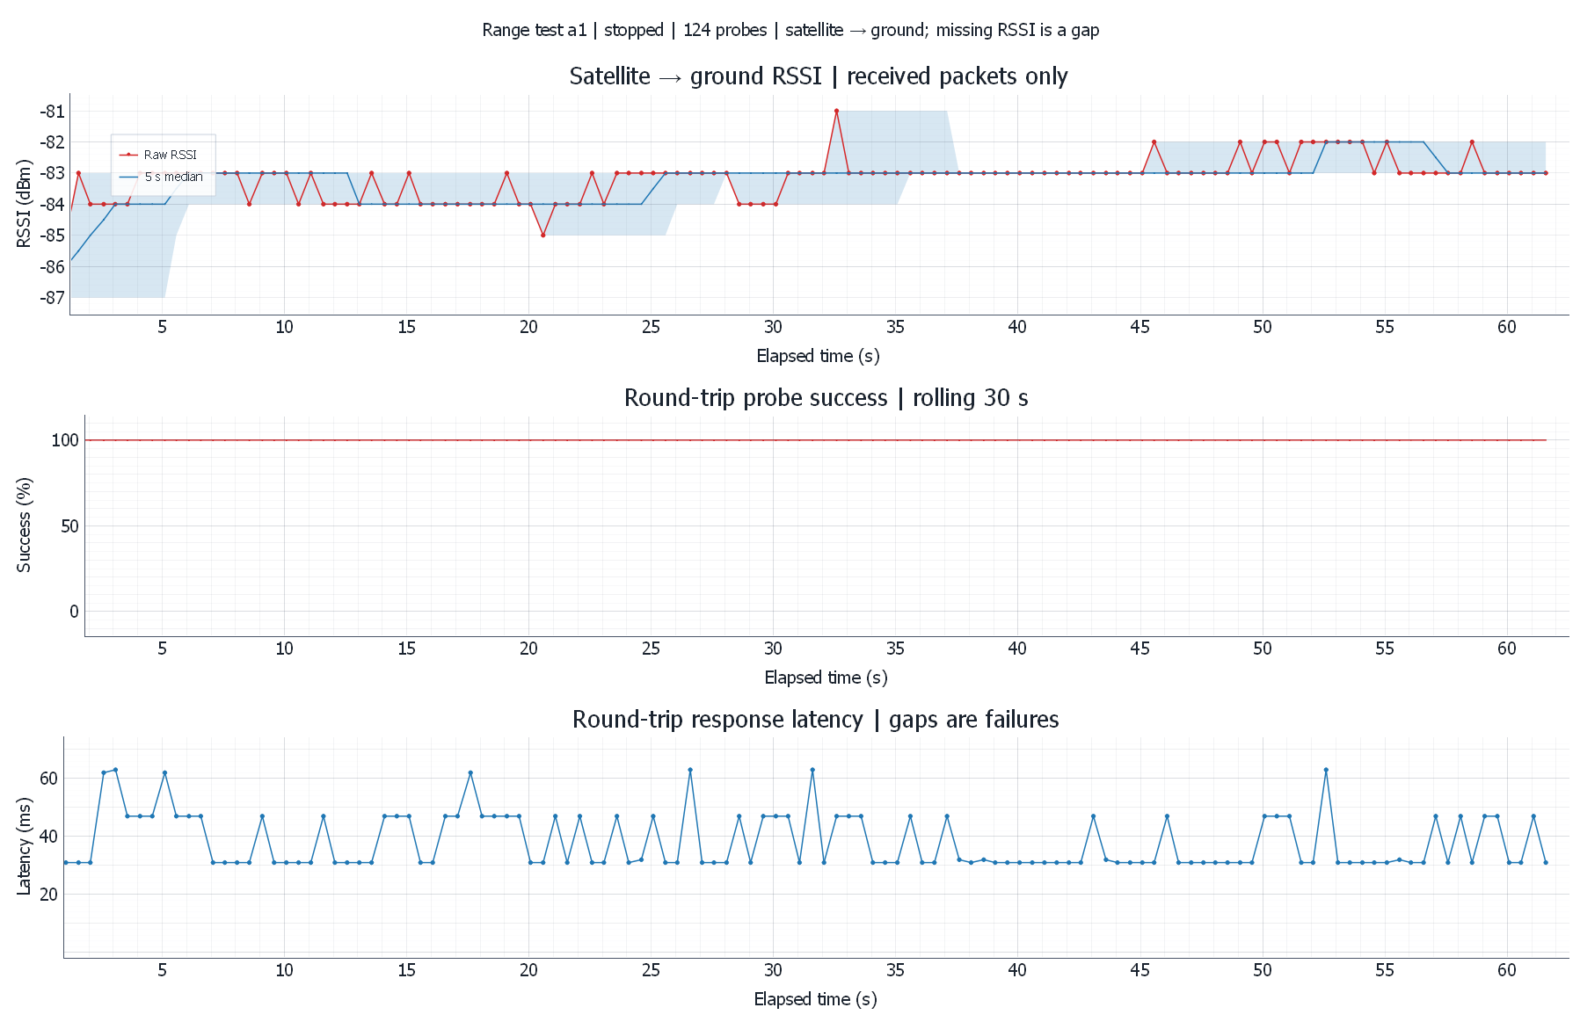
Long-Range Test Setup, 417m
Reqts & Progress
Data & Analysis
Plan & Delivery
3
Notes:
115200 baud rate, unicast mode, w/ rssi

Slide 14
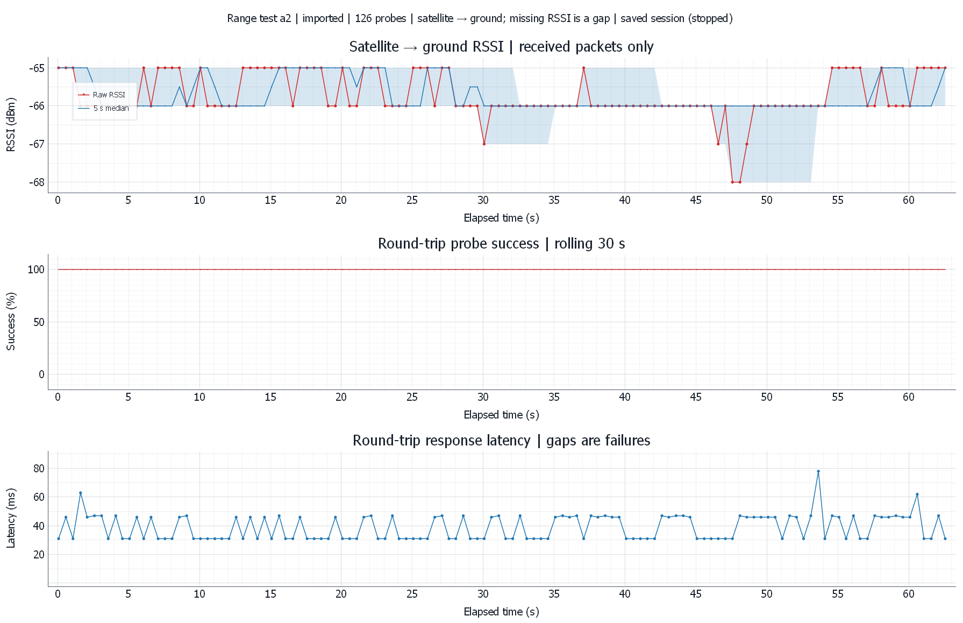
Long-Range Test Setup, 775m
Reqts & Progress
Data & Analysis
Plan & Delivery
3
Notes:
115200 baud rate, unicast mode, w/ rssi

Slide 15
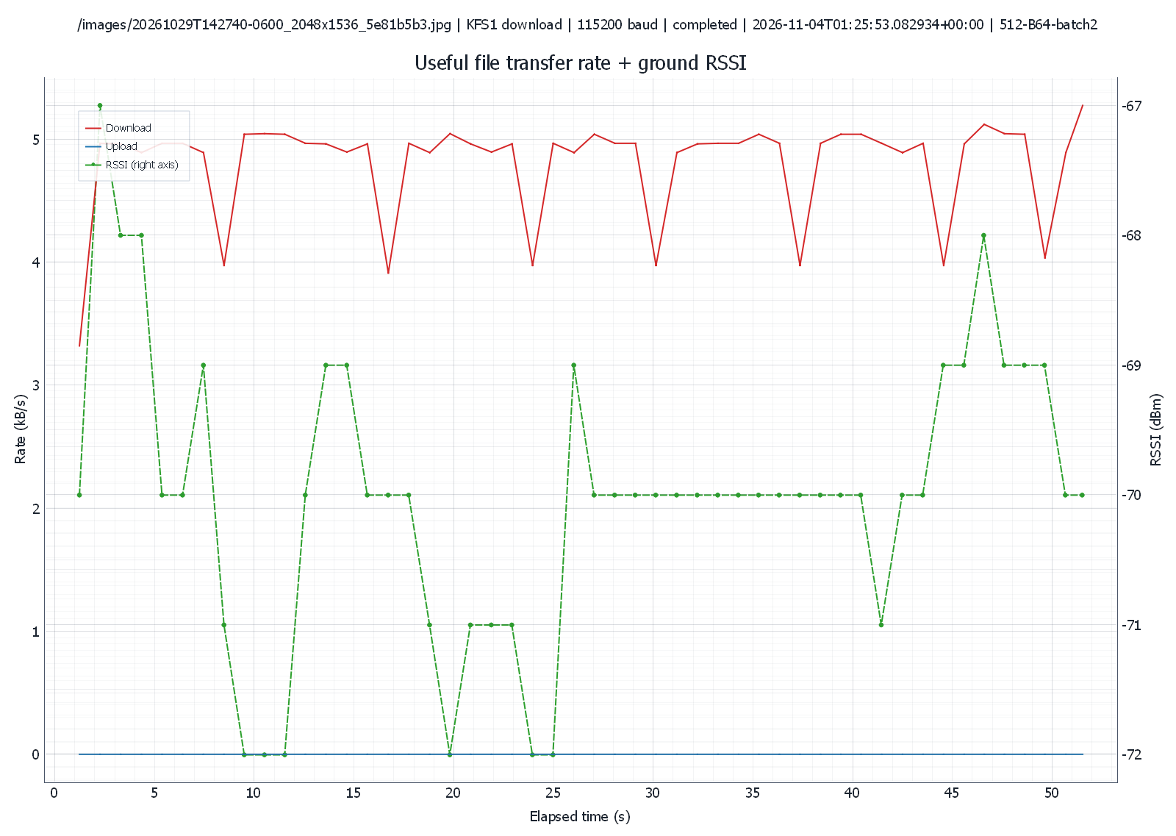
Long-Range Test Setup, 775m Speed Test
Reqts & Progress
Data & Analysis
Plan & Delivery
3
Notes:
115200 baud rate, unicast mode, w/ rssi

Slide 16
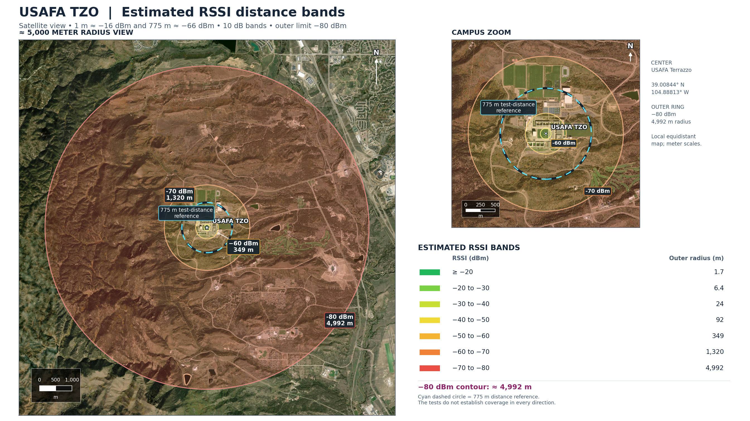
Long-Range Test Setup, 775m Speed Test
Reqts & Progress
Data & Analysis
Plan & Delivery
3
Notes:
115200 baud rate, unicast mode, w/ rssi

Slide 17
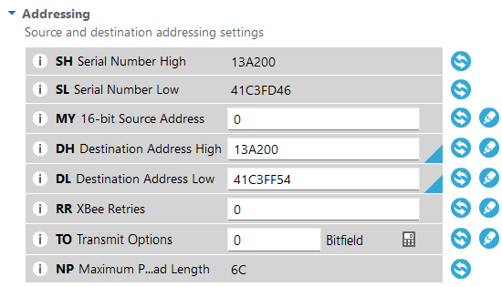
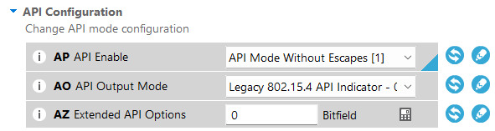
Code, XCTU Programming
Reqts & Progress
Data & Analysis
Plan & Delivery
Unicast mode
Increased baud rate
AP=1 for RSSI
3
Notes:
115200 baud rate, unicast mode, w/ rssi

Slide 18
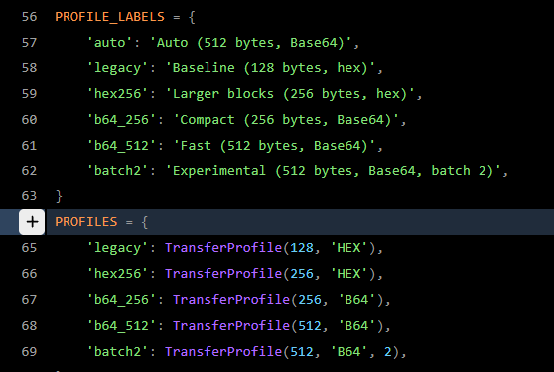
Code, Transfer Rate Improvements
Reqts & Progress
Data & Analysis
Plan & Delivery
Separate profiles in the GCS
Different testing parameters
Legacy – built-in with GCS
Batch 2 – experimental
3
Notes:
115200 baud rate, unicast mode, w/ rssi

Slide 19
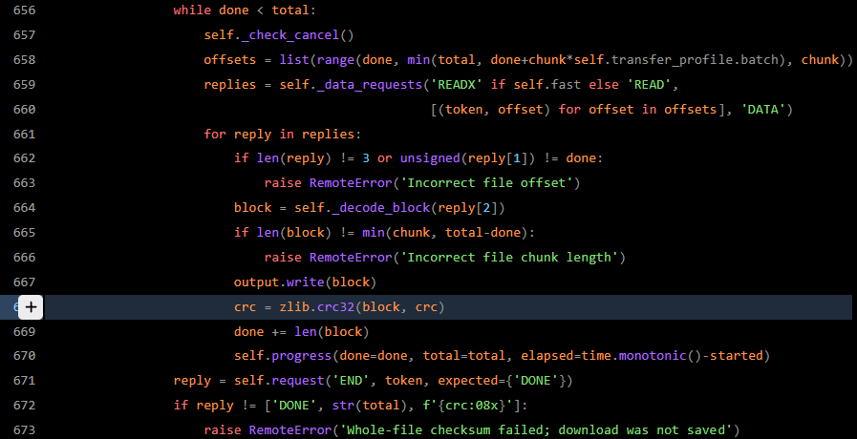
Code, Transfer Verification
Reqts & Progress
Data & Analysis
Plan & Delivery
Checksum verification
Verifies all packets received and correct
Reports failures
3
Notes:
115200 baud rate, unicast mode, w/ rssi

Slide 20
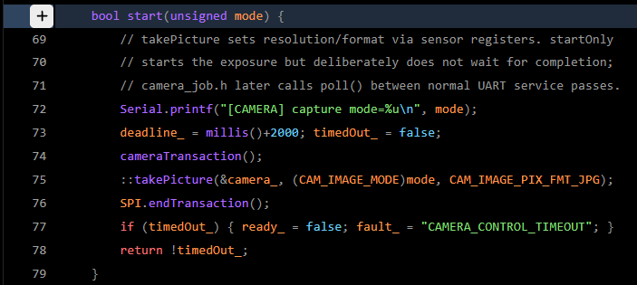
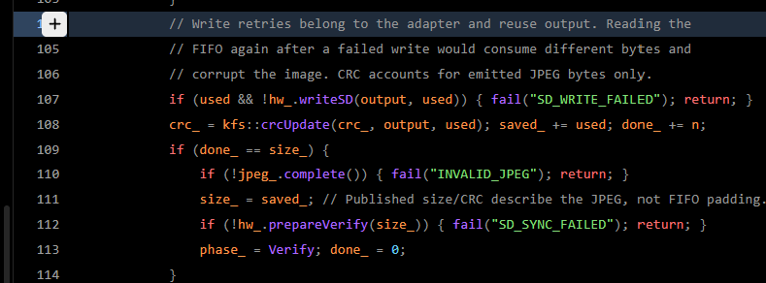
Code, Image Capture and Saving
Reqts & Progress
Data & Analysis
Plan & Delivery
3
Notes:
115200 baud rate, unicast mode, w/ rssi

Slide 21
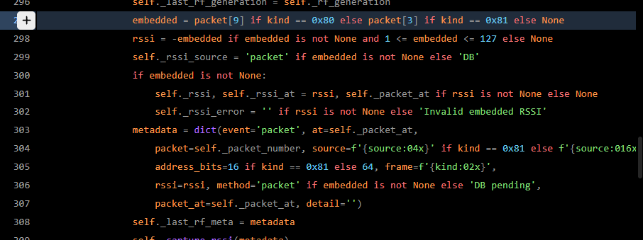
Code, RSSI Extraction
Reqts & Progress
Data & Analysis
Plan & Delivery
Reads RSSI data reported by KestralSAT
Verifies RSSI data is transferred and formatting correctly
Manages failed RSSI reads
3
Notes:
115200 baud rate, unicast mode, w/ rssi

Slide 22
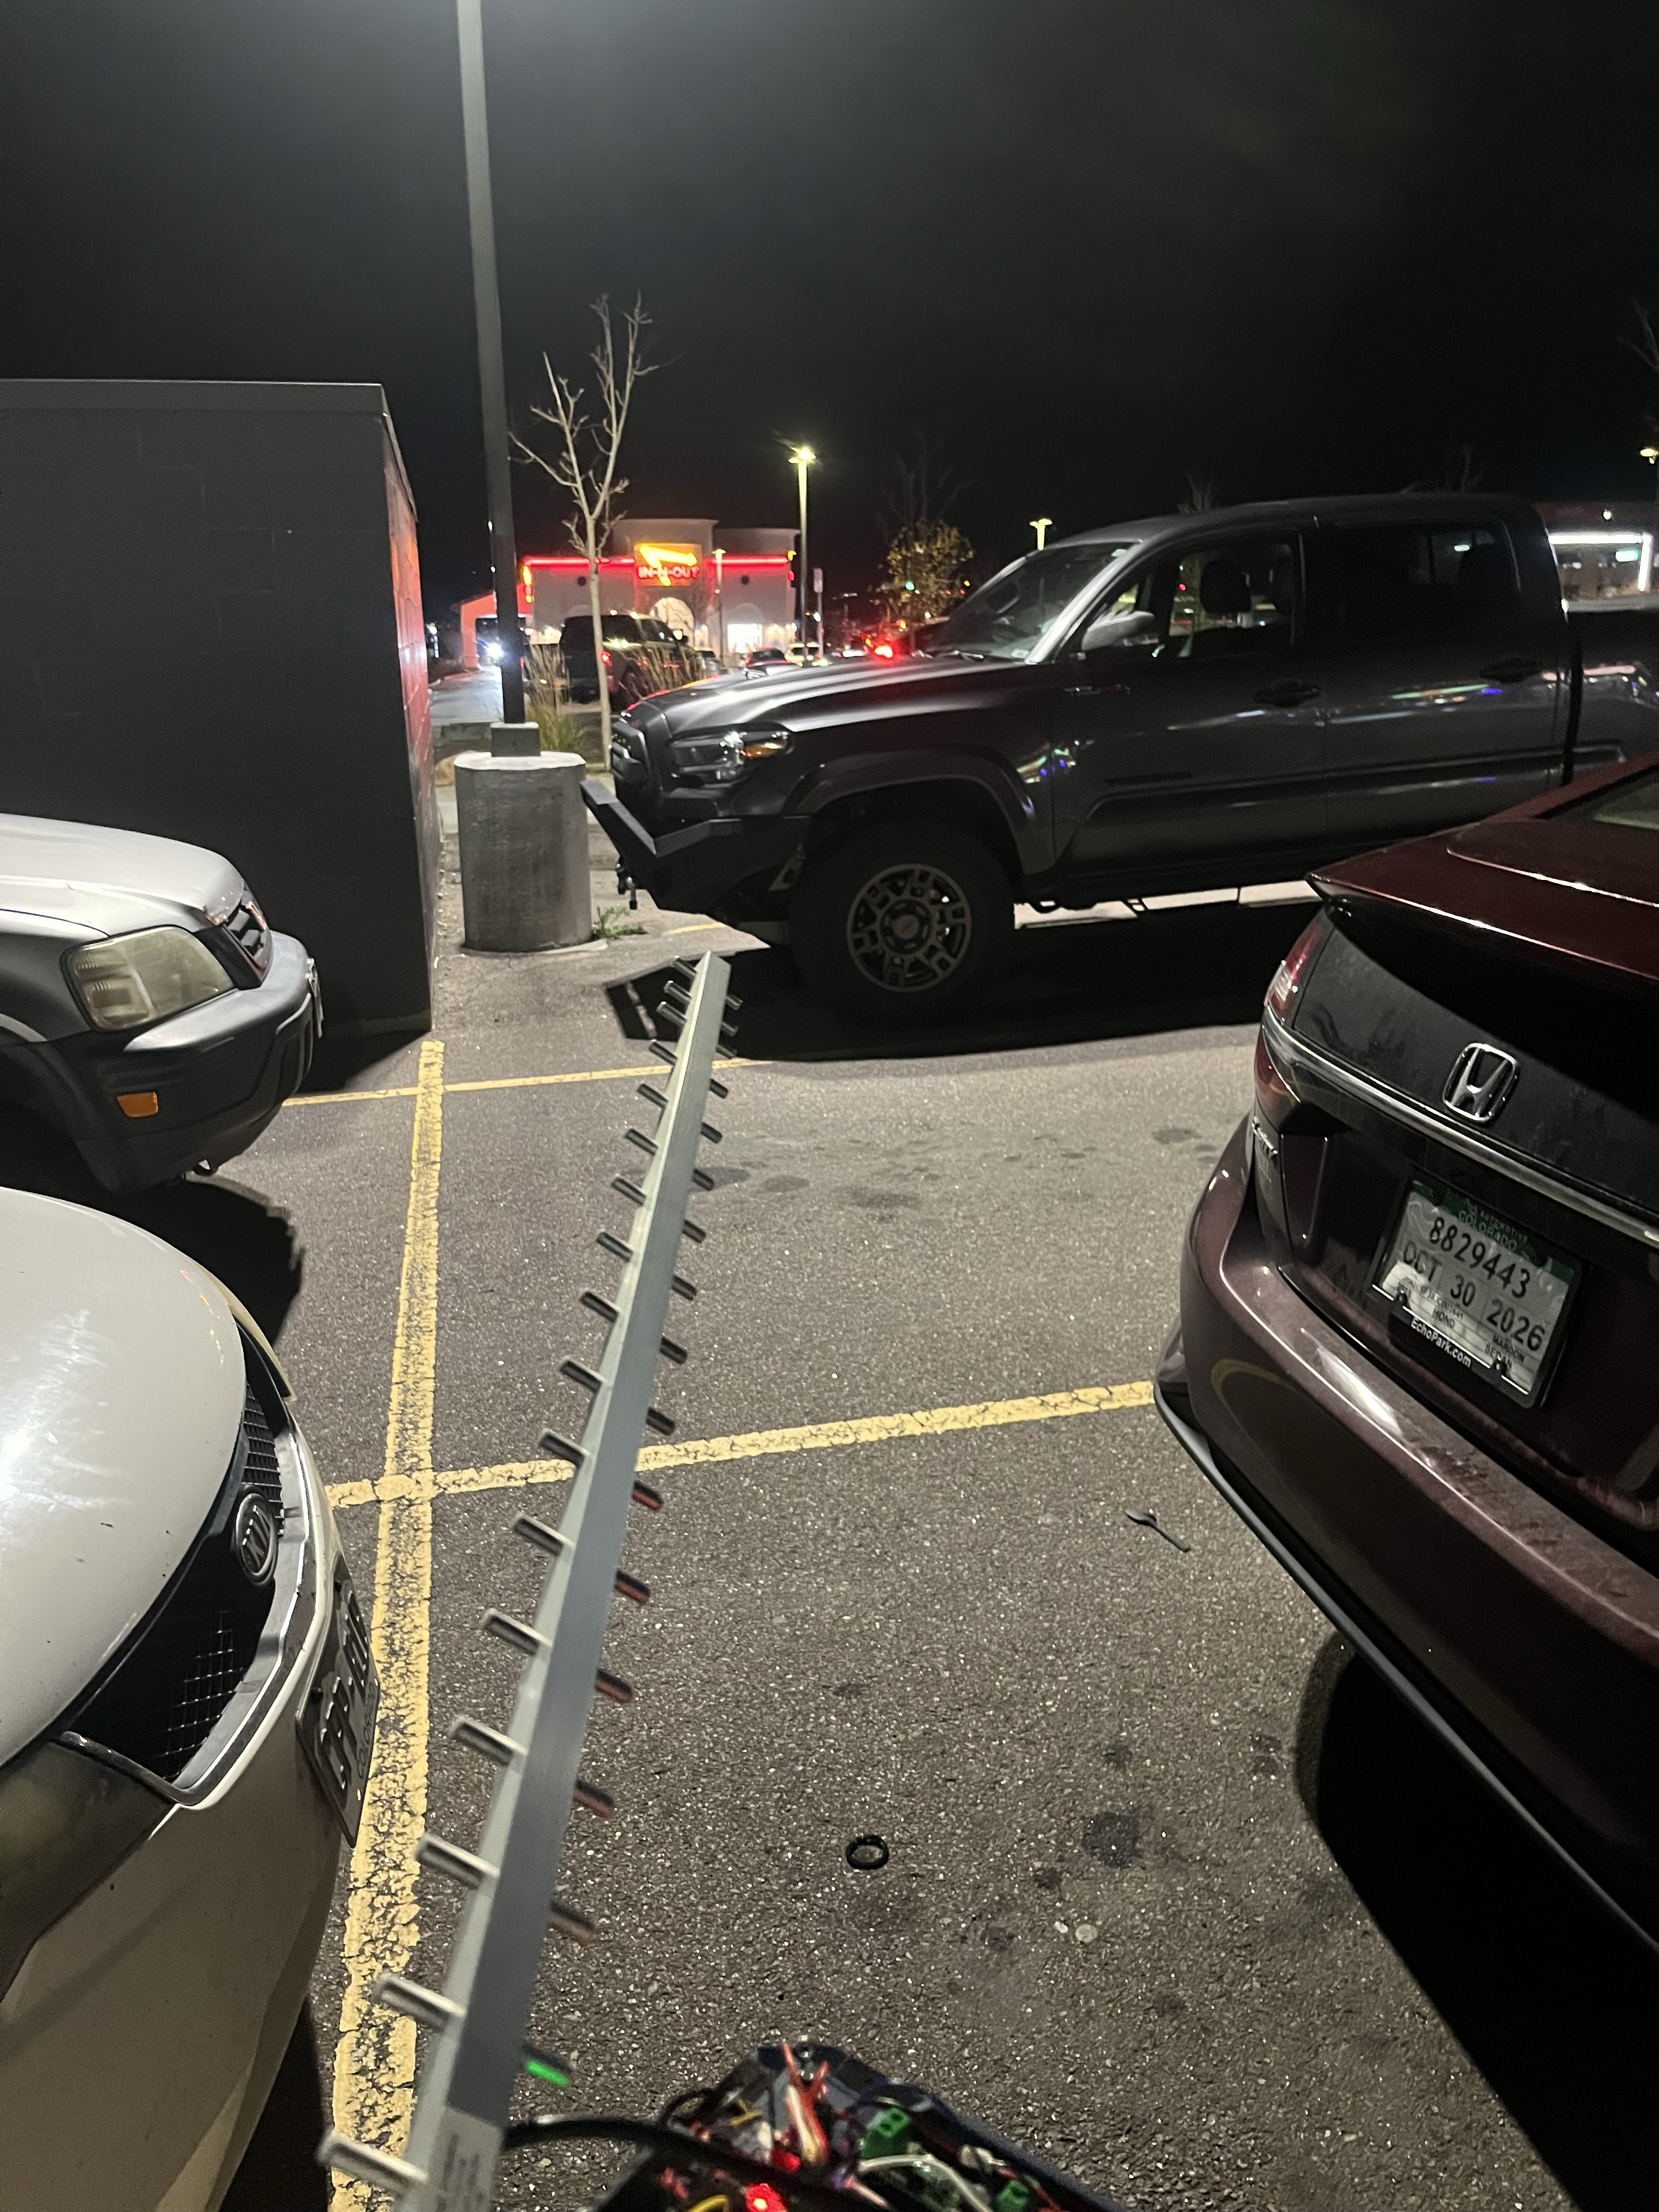
Long-Range Test Limitations and Results
Reqts & Progress
Line of Sight issues
External interference
Weird looks from the public
Weather
Pointing accuracy
Data & Analysis
Plan & Delivery
Expected max range: ~3 - 5 miles
Attempts from 5, 4, and 2.5 miles failed
Both remote imaging and data transfer worked; transmission rate consistent
3
Notes:
115200 baud rate, unicast mode, w/ rssi

Slide 23
Plan Forward & Presentation
Verification & plan forward
Due-outs
Reqts & Progress
•
We currently have working code to measure RSSI, upload speed, manage files and take pictures
•
Need to improve and optimize to decrease delay of system
Data & Analysis
•
We have tested RSSI with and without obstacles, proving that our system is capable of transmitting/receiving/file editing remotely
•
Still need to test long-distance transmission with RSSI measurements and file management including a live image preview
Plan & Delivery
•
Our lab combines remote transfer with imagery while also improving the KestrelSAT GUI
•
Next steps/Lab 9: better camera, large antennas, LASER transmission
•
Our code works with a low transmission error rate for all functions
Image capture works and can be triggered remotely
•
Future Timeline/Workflow
01
02
03
Optimize code and decrease delay times
Test long distance and improve to meet goals outlined & generate a live preview
Possible continuation and continuous iteration
Risks: Running out of ChatGPT tokens while troubleshooting, hardware not capable enough, hardware not delivered in time
4
Notes:
What have you built?
What have you tested, and what does your data prove?
What is working?
What needs improvement?
How will you complete and verify the project?

Slide 24
Deliverables
Requirement | Verification Method | Status
Remotely capture and transmit images | Reliably and without failure capture and transmit files and images at 1 KBps speed | Exceeded
RSSI > -140 dB for distances < 100m regardless of obstruction | Measure RSSI with various obstructions while meeting or exceeding -140 dB RSSI | Met
Establish communication at 2km+ range | Use mapping software to determine 2km+ line-of-sight points and maintain connection | Pseudo-Met
Transmit a live preview of the image | Maintain 10s intervals of 320p image transmission to the ground station without saturating the connection | Met
Reqts & Progress
Data & Analysis
Plan & Delivery
Deliverables
2

Slide 25
Live Demo
Reqts & Progress
We will now demonstrate our KestralSAT taking a remote image of our class!
Data & Analysis
Plan & Delivery
3
Notes:
640x480 image takes ~20s

Slide 26
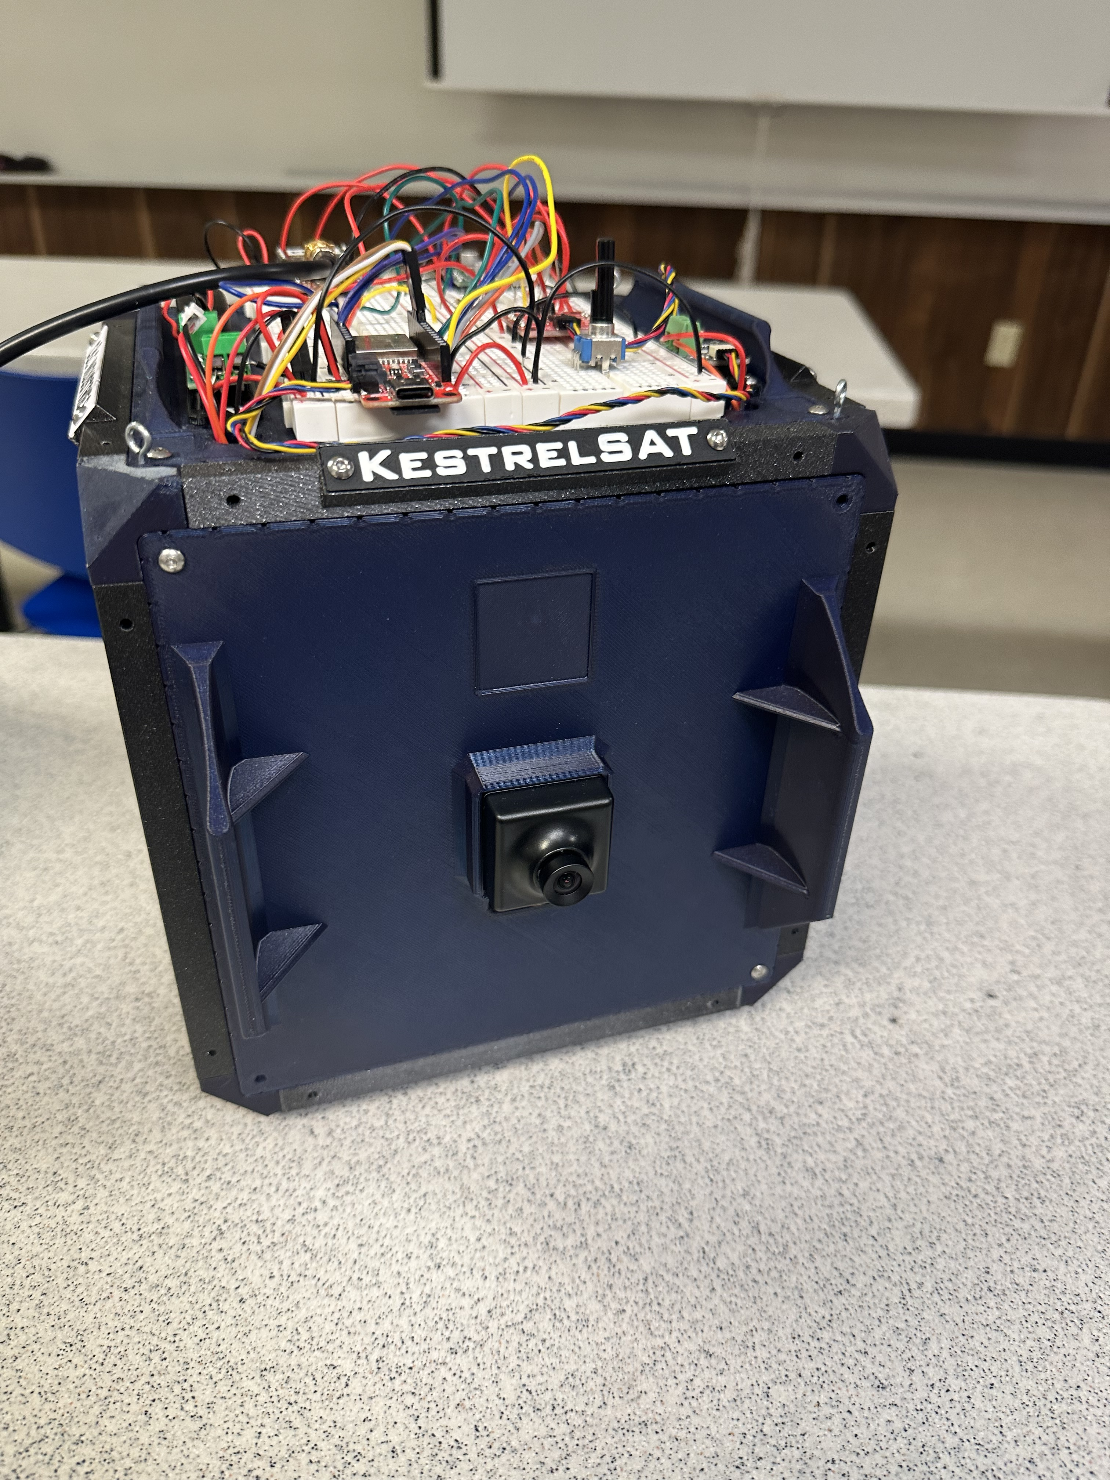
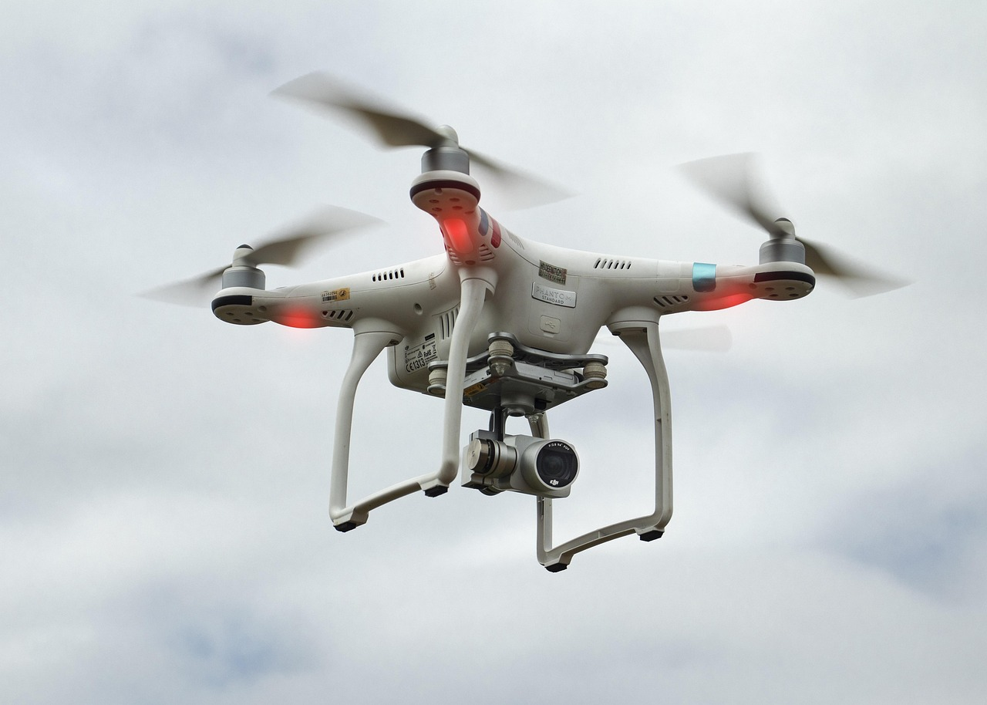
Future Work
Long-range testing environment (Kansas)
Ariel testing with a sUAS
Refined GCS platform for our use case
Larger and fixed antennas
Improved testing with camera
  Larger sensor
  Auto-focus
Reqts & Progress
Data & Analysis
Plan & Delivery
3
Notes:
115200 baud rate, unicast mode, w/ rssi

Slide 27
Reqts & Progress
Data & Analysis
Questions
Questions?
4

Slide 28
Documentation:
We used copious amounts of ChatGPT tokens. Various discussions were had with Codex to create the code for this project. Two Github Repos were used. The Lab 8 Repo holds the firmware of the KestralSAT and is based off the code from Labs 4 and 5. The second repo is forked from the KestralSAT GCS and has been improved upon to enable the features discussed in this presentation. Codex has reliably updated the readme.md file with documentation of everything that has occurred. The full Codex log is below: https://chatgpt.com/s/cx_6adae56718988191aaf138bb82137366
Reqts & Progress
Data & Analysis
Plan & Delivery
Deliverables
4

